Slide 1
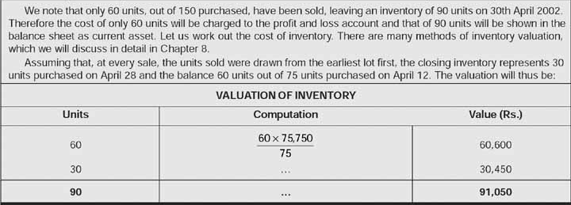
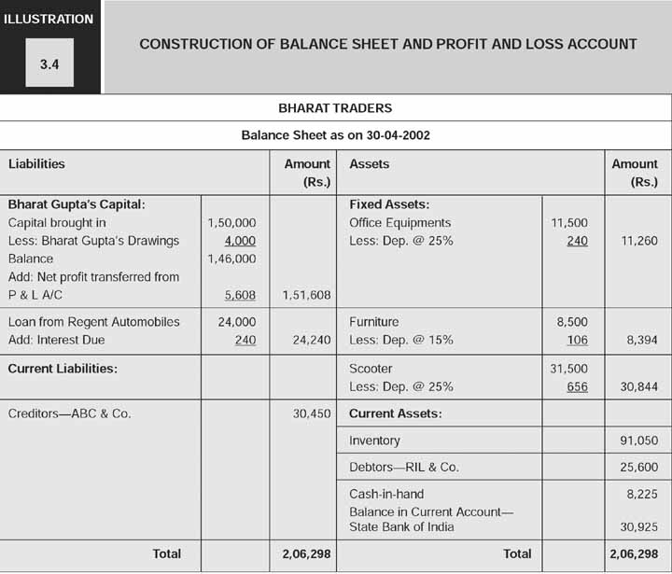
▪Construction of balance sheet and profit and
Loss account
10/10/2020
FRMA - Dr. Gaurav Agrawal, ABV-IIITM

Slide 2
10/10/2020
FRMA - Dr. Gaurav Agrawal, ABV-IIITM

Slide 3
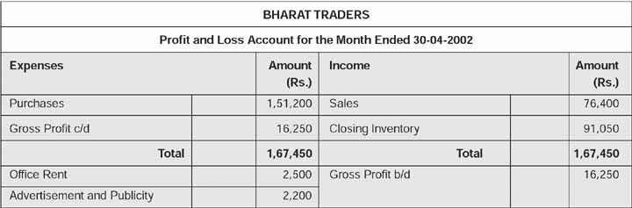
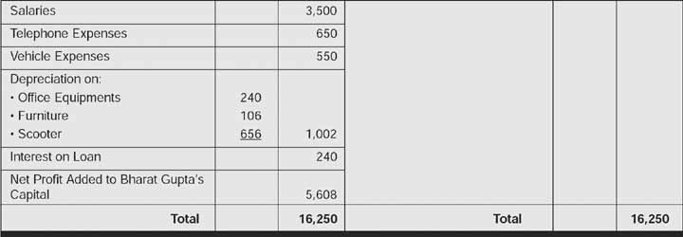
10/10/2020
FRMA - Dr. Gaurav Agrawal, ABV-IIITM

Slide 4
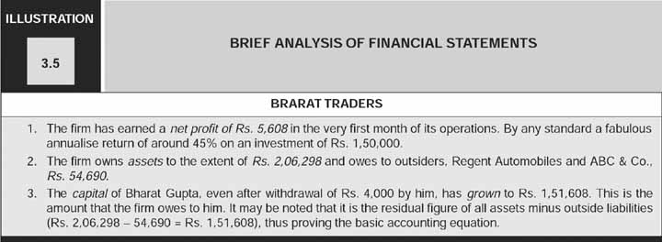
Brief analysis of the financial statements of
Bharat traders
10/10/2020
FRMA - Dr. Gaurav Agrawal, ABV-IIITM

